Slide 1
Crystallisation in oxidic slag systems
Influence of Parameters on the Crystallisation Behaviour of Oxidic Slag Systems Determined by CLSM Investigations
04.04.2019 I Jan Peter Schupsky

Slide 2
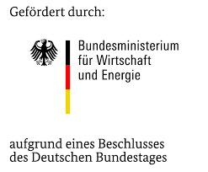
HotVeGas
Phase III
High temperature gasification processes
IGCC power stations with CO₂-separation and syngas
H₂, CH₄, methanol, liquid fuels
Increasing operational efficiency from ~45 % to 55 %
End of the project 2019

Slide 3
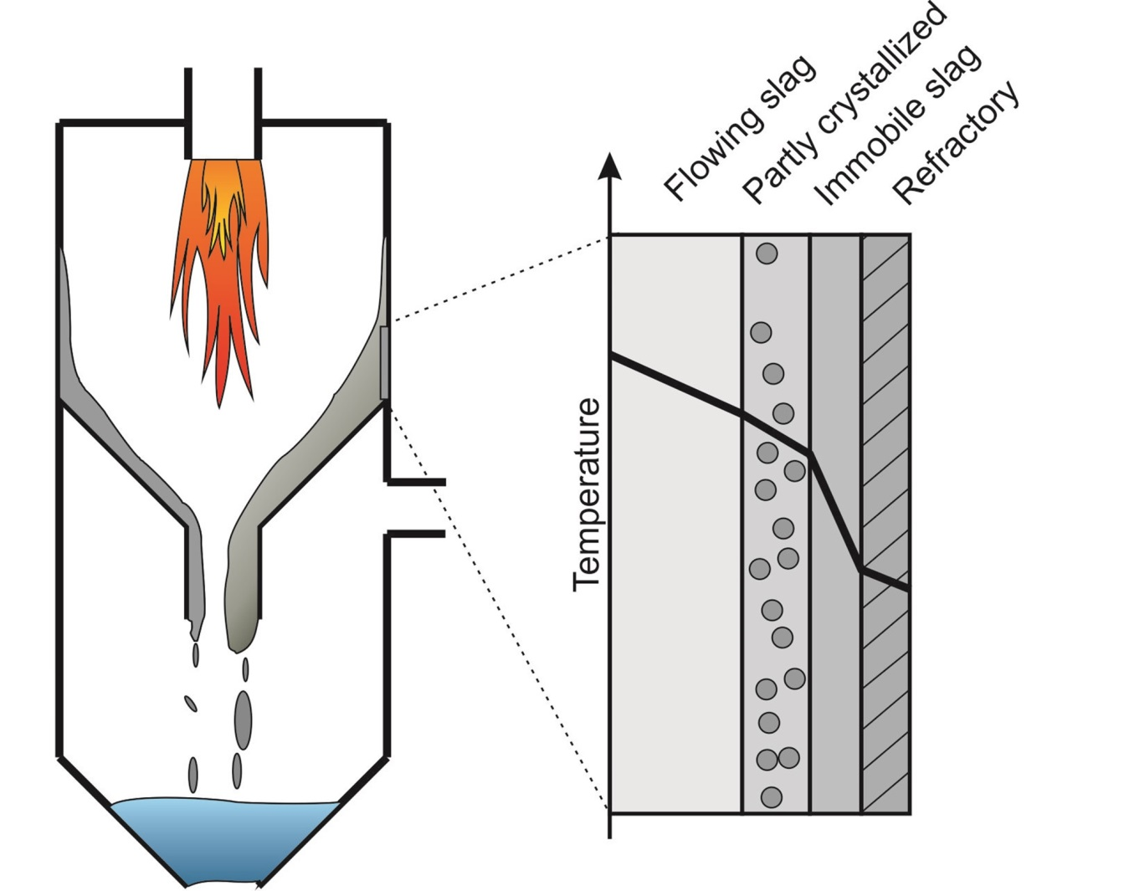
Fuel gasification
The importance of slag behavior
Fuel gasification to generate energy, $λ≈0.1$
Slag as a „waste“ material
Constant slag tapping required
Prevention of slag blockage
Slag viscosity < 25 Pa*s recommended
Supercooled slag → crystallisation
Crystallisation strongly increases viscosity
η
Crystallisation processes in oxidic slags
Seebold, 2017, modified

Slide 4
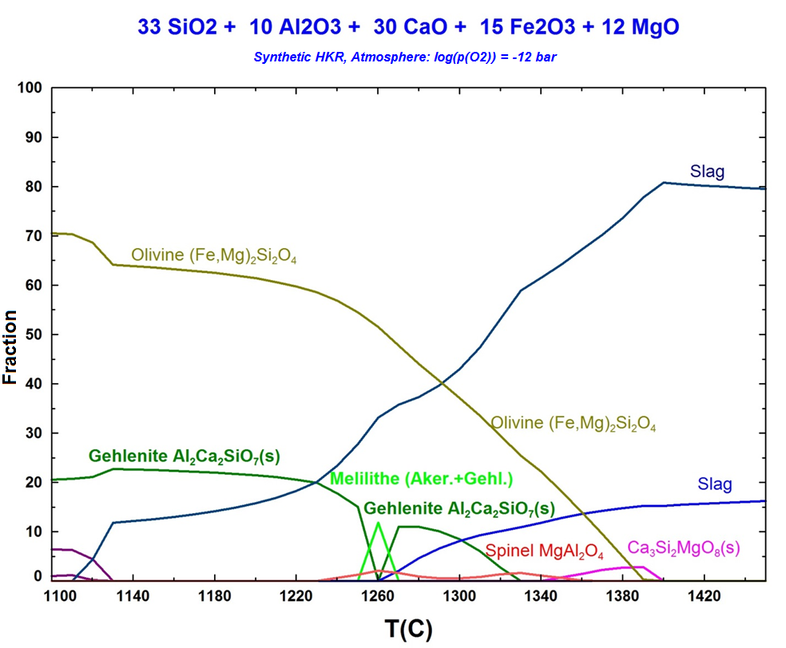
Scientific approach
Synthetic slag system, thermochemical calculations, experimental validation
wt% | SiO₂ | Al₂O₃ | CaO | Fe₂O₃ | MgO
ST-D-2² | 60% | 20% | 11% | 9%
HKR¹ | 33% | 10% | 30% | 15% | 12%
HKT¹ | 55% | 21% | 15% | 3% | 6%
¹Melchior, 2011, ²Seebold, 2017
Equilibrium calculations (FactSage, GTox)
Phase predictions as „benchmark“
Reducing atmosphere
Melilithe, olivine, spinel
Fe-rich slag system with low viscosity
Notes:
Graph: log(p(O2)) = -12 bar, Y achse
Notiz: 2 Schlacken: wegen miscibility von red. Fe in Schmelze

Slide 5
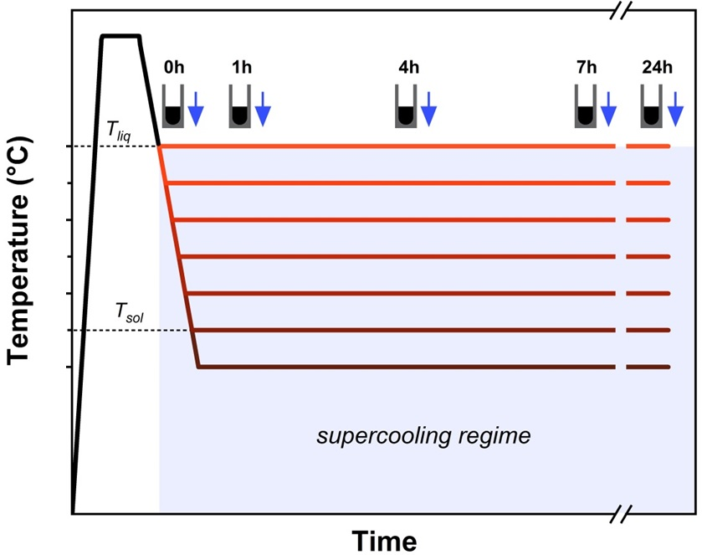
Scientific approach
Kinetic investigation via quenching experiment
wt% | SiO₂ | Al₂O₃ | CaO | Fe₂O₃ | MgO
ST-D-2² | 60% | 20% | 11% | 9%
HKR¹ | 33% | 10% | 30% | 15% | 12%
HKT¹ | 55% | 21% | 15% | 3% | 6%
¹Melchior, 2011, ²Seebold, 2017
Quenching experiment
Supercooling of slag samples
Variation of time and temperature
Phase analysis via XRD and SEM-EDX
Thermodynamics vs. kinetics

Slide 6
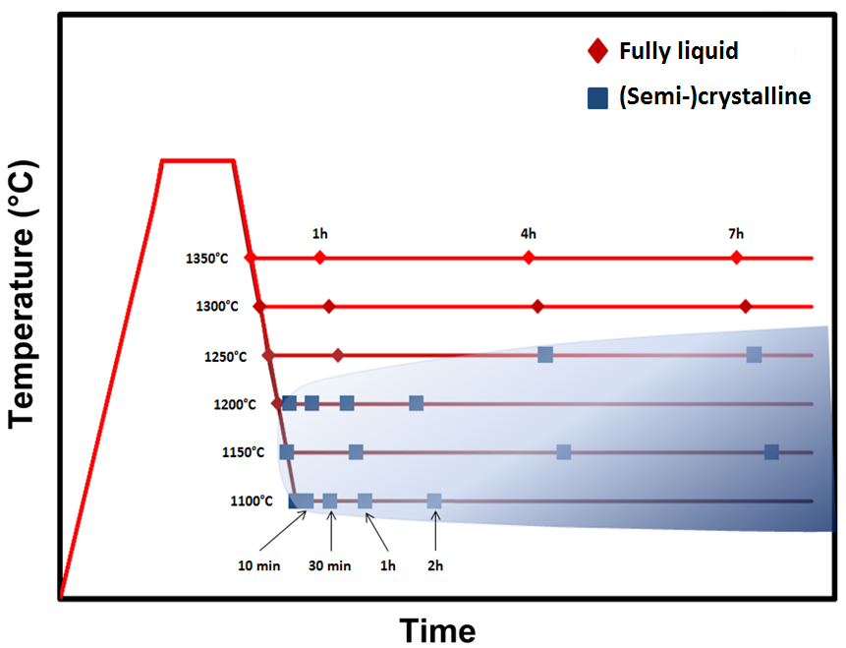
Scientific approach
TTT diagram, unsufficient cooling conditions
wt% | SiO₂ | Al₂O₃ | CaO | Fe₂O₃ | MgO
ST-D-2² | 60% | 20% | 11% | 9%
HKR¹ | 33% | 10% | 30% | 15% | 12%
HKT¹ | 55% | 21% | 15% | 3% | 6%
¹Melchior, 2011, ²Seebold, 2017
Quenching experiment
Supercooling of slag samples
Variation of time and temperature
Phase analysis via XRD and SEM
?
Experimental approach inadequate
?

Slide 7
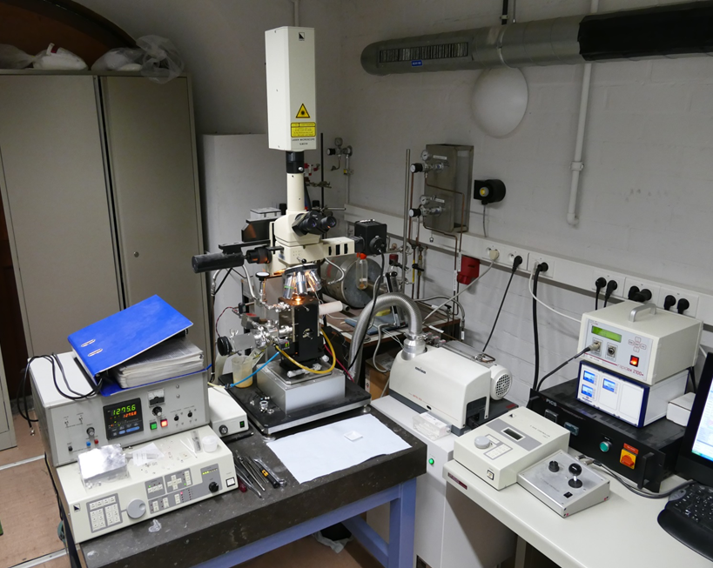
Confocal laser scanning microcscope (CLSM)
In situ observation including high slopes
Materiaalkunde Dep., KU Leuven
Permanent operation (XYZ, zoom, Intensity)
Ar-gas with Mg furnace
High temp. furnace + laser microscope
In situ imaging
KU Leuven
Notes:
Weniger bullet points
schneller

Slide 8
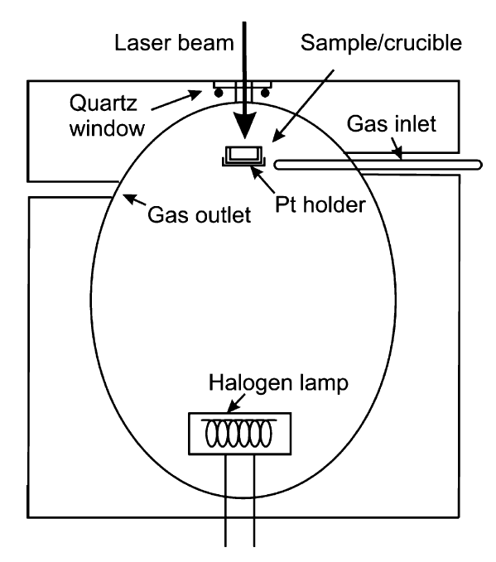
Confocal laser scanning microcscope (CLSM)
In situ observation including high slopes
High temp. furnace + laser microscope
In situ imaging
High heating/cooling slopes
Small amount of sample
Jones et al., 2007

Slide 9
Confocal laser scanning microcscope (CLSM)
In situ observation including high slopes
Influence of sample state (heterogeneous nucleation)
Usage of Pt-crucible (alloy forming)
O₂ partial pressure (reducing conditions)
Jones et al., 2007

Slide 10
CLSM
Unexpected crystallisation due to heterogeneous nucleation
T_{liq}
T_{max}
Fe-Al-spinel → Hercynite
T_{melt} $≈$ 1780 °C*
Pre-treatment of synthetic samples prevents heterogeneous nucleation
Temperature profile
*Fukushima et al., 2013
Notes:
Scale bar clsm image

Slide 11
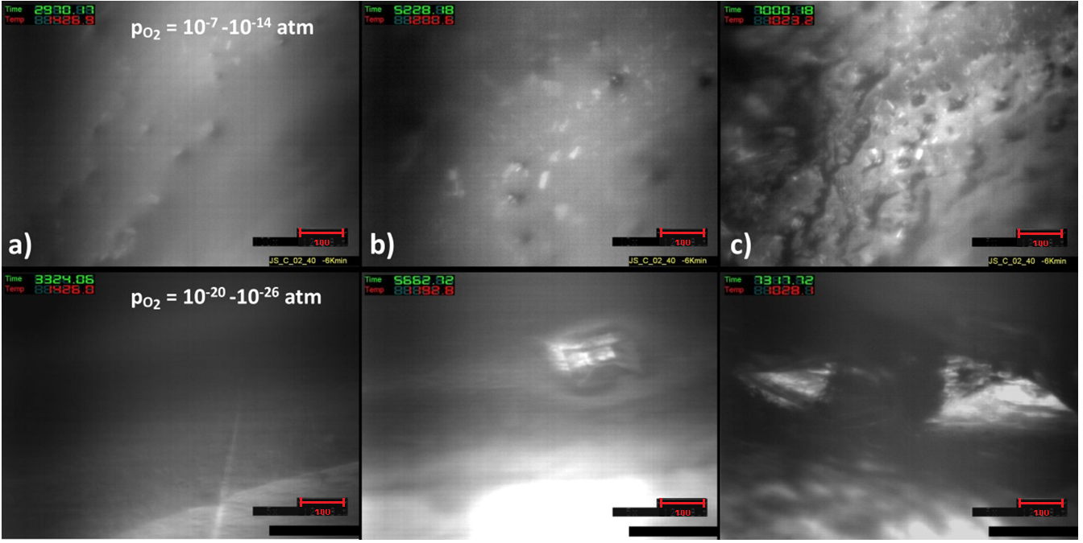
CLSM
O2 partial pressure influencing crystallisation tendencies
$≈$1380 °C
$≈$1160 °C
$≈$990 °C

Slide 12
CLSM
O2 partial pressure influencing crystallisation tendencies
$≈$1380 °C
$≈$1160 °C
$≈$990 °C
Oxidizing conditions support crystallisation

Slide 13
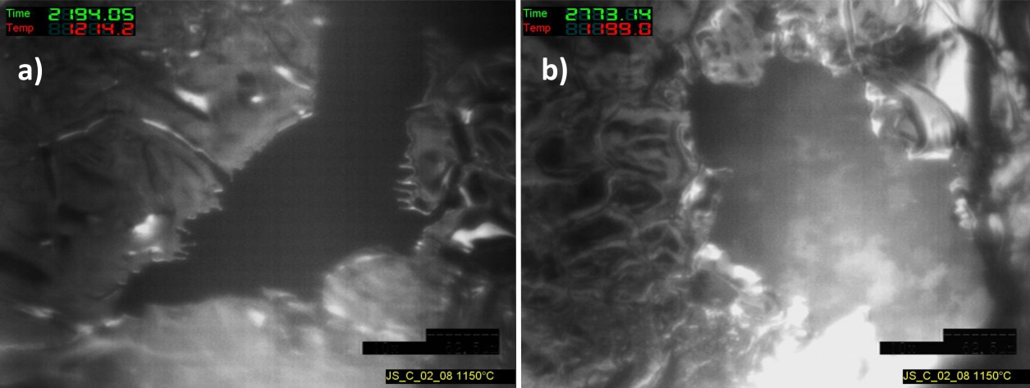
CLSM
O2 partial pressure influencing
Fe-Pt-alloy with low T_{liq}
Pt-crucible failure
Usage of Mo-crucibles
Very low O₂ partial pressure lead to reduction of FeO_{X}
Catalytic effect of Pt accelerates FeOx-reduction
Fe + Pt → Fe-Pt-alloy
Mo-crucibles suitable for Fe-containing oxidic slags at low p(O₂)
Notes:
Übergang → Anwendung Erfahrung aus Impact von Parameters

Slide 14
CLSM - Crystallisation
Melilithe formation in supercooled HKR slag

Slide 15
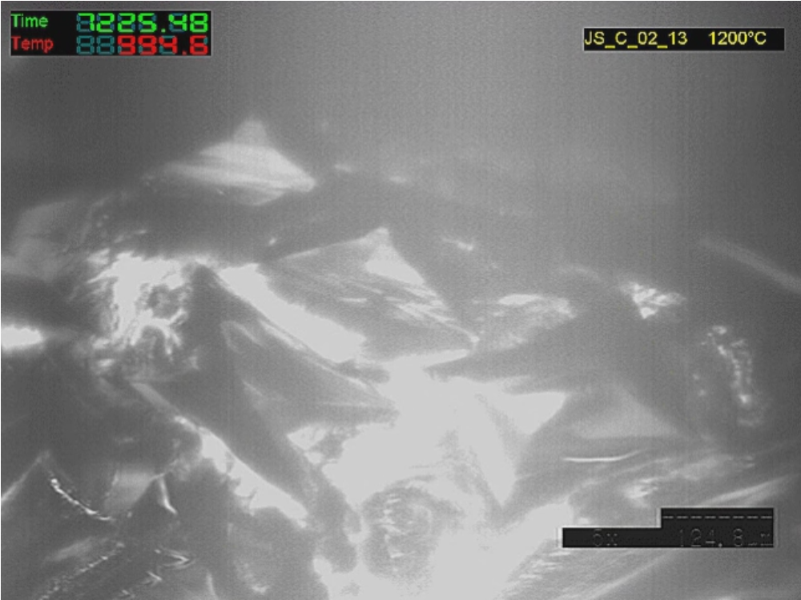
CLSM - Crystallisation
Melilithe formation in supercooled HKR slag

Slide 16
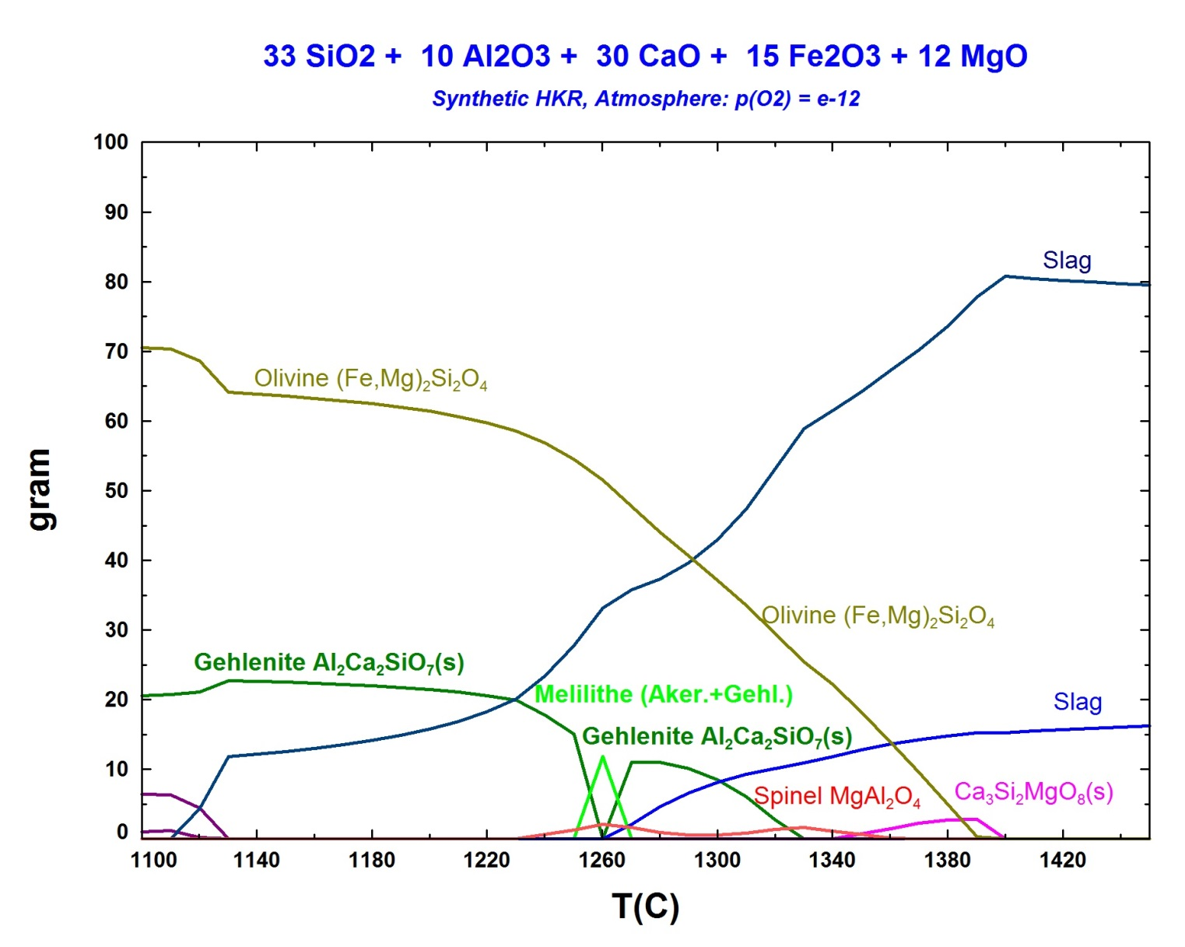
CLSM - Crystallisation
Melilithe formation in supercooled HKR slag

Slide 17
Conclusion
Summarizing key findings
Oxidic slags with high Fe₂O₃ content lead to various crystallisation products
High Fe₂O₃ content entails low viscosity (η) and high crystallisation kinetics
Heterogeneous sample state lead to uncontrollable crystallisation (pre-treatment required)
Lower p(O₂) retards crystallisation processes
Reducing atmosphere + Fe₂O₃ containing slag + Pt-crucible → Crucible failure (Fe-Pt-alloy)
Melilithe formation in HKR slag showing high symmetric morphologies (tetragonal pyramidal)
Notes:
Abstände zwischen bullet points anpassen, gruppe von ergebnissen besser darstellen

Slide 18
Thank you for your attention
04.04.2019 Jan peter schupsky
j.schupsky@fz-juelich.de

